Slide 1


DEPARTMENT OF COMPUTER SCIENCE AND ENGINEERING
20CS7503 & DESIGN PROJECT – III
END SEMESTER PRACTICAL EXAMINATION- NOV / DEC 2025
REVIEW PRESENTATION
Batch No.:16
Date:01/12/2025
Session:AN

Slide 2
Medi portal – ML based Health recommendation Platform
Guide Name:
Ms.V.Sowmiya
AP(CSE)
Team Members:
P.Abinaya(811722104003)
P.Charumathi(811722104024)
A.Jane Beula(811722104060)

Slide 3
OBJECTIVE OF THE PROJECT
To develop an AI-powered medical portal using LLM technology for accurate symptom analysis and disease prediction.
To provide personalized health recommendations including diet, lifestyle, and basic medical guidance.
To integrate real-time hospital suggestions based on the user’s GPS location for quick medical access.
To enable emergency assistance features that support users during severe or critical health conditions.
To enhance user experience through fast, reliable, and intelligent health insights using AI-driven analysis.

Slide 4
INTRODUCTION
Traditional symptom-checking systems are rule-based and often fail to accurately understand user-provided medical symptoms.
These systems struggle with natural language input, leading to generic and unreliable health recommendations.
The proposed Medi Portal uses advanced LLM technology (Gemini 2.5 Flash) to analyze symptoms with higher accuracy.
A RAG mechanism enhances the system by retrieving relevant medical knowledge to support more reliable predictions.
The system also offers personalized recommendations, nearby hospital suggestions, and emergency support for critical cases.

Slide 5
LITERATURE SURVEY
TITLE OF PAPER | AUTHOR(S) | PAPER GIST | TECHNOLOGY USED
Symptom Checker Using Static Dataset | P. Sinha | Designed a web tool that matches user symptoms to fixed dataset entries; lacks AI learning or personalization | PHP, MySQL
Disease Diagnosis Using Decision Tree | S. Gupta | Uses traditional ML algorithms with poor accuracy for multi-symptom analysis and no chatbot integration | Decision Tree
Hospital Finder Web App | L. Thomas | Locates hospitals by region but lacks user profile linkage and severity-based recommendations. | Google Maps API, JavaScript
Basic Health Chatbot System | R. Verma | The system uses simple rule-based replies for health-related questions but fails to predict diseases accurately. | Python, AIML

Slide 6
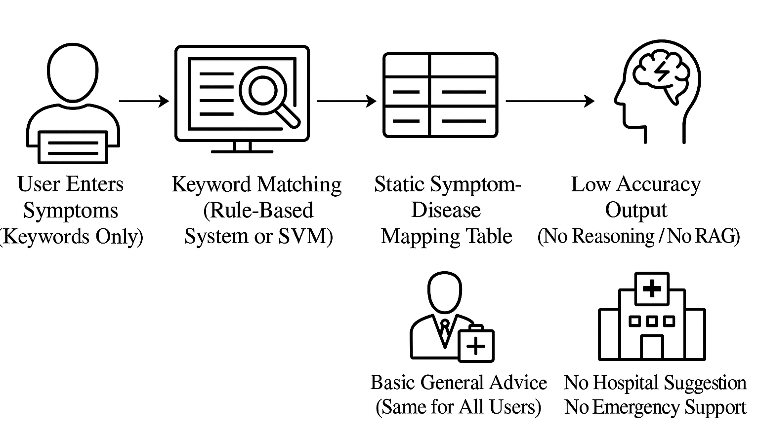
EXISTING SYSTEM ARCHITECTURE

Slide 7
PROBLEM IDENTIFICAITON
Existing symptom-checking systems rely on fixed rule-based or keyword-matching methods, leading to low accuracy and unreliable results.
They cannot properly understand natural language symptom descriptions, especially when users describe symptoms in long or varied sentences.
Traditional ML models like TF-IDF + SVM struggle with medical terminology, abbreviations, and misspellings, reducing prediction quality.
These systems do not provide personalized recommendations and often give generic, same-for-all suggestions.
There is no support for real-time features such as nearby hospital location detection or emergency assistance during critical conditions.

Slide 8
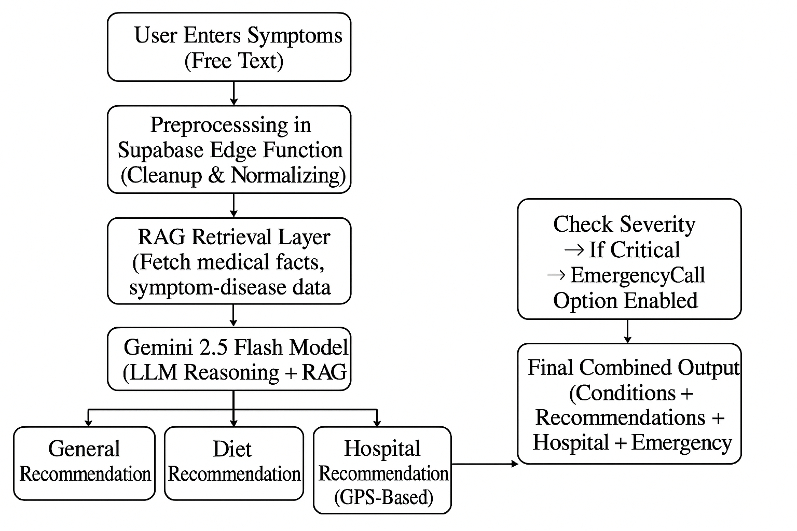
PROPOSED SYSTEM ARCHITECTURE

Slide 9
SOFTWARE AND HARDWARE REQUIREMENTS
HARDWARE
1. Processor: Intel i5 or higher
2. RAM: 8GB minimum
3. Storage: 512GB HDD or higher
SOFTWARE
HTML, CSS, JavaScript, TypeScript.
Supabase Edge Functions
Supabase PostgreSQL DB
Tools :VS Code, Node.js, Geolocation API.

Slide 10
MODULES
User Authentication & Profile Management
Symptom Analysis (LLM + RAG Engine)
Health Recommendations Module
Hospital Locator & Nearby Medical Support
Emergency Assistance Module

Slide 11
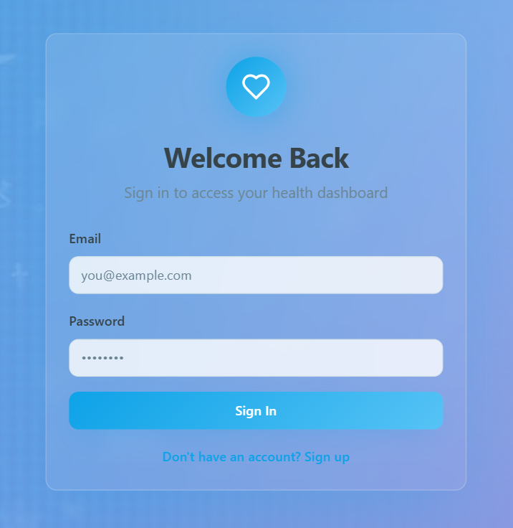
1.User Authentication & Profile Management
Handles secure login and signup using Supabase Authentication with JWT-based identity verification.
Manages user profiles stored in Supabase PostgreSQL for personalized medical recommendations. TypeScript is used to fetch, update, and maintain user data securely.

Slide 12
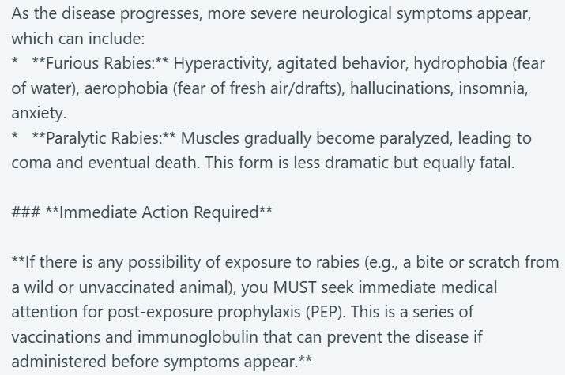
2.Symptom Analysis (LLM + RAG Engine)
Integrates with RAG and Supabase Edge Functions handle preprocessing and send structured prompts to the LLM.
Processes free-text symptoms using the Google Gemini 2.5 Flash LLM to understand natural language.

Slide 13
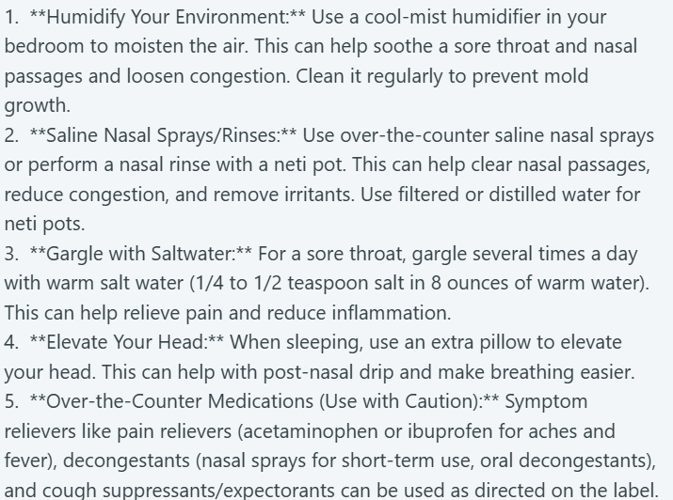
3.Health Recommendations Module
Generates user-specific general recommendations based on symptoms and model-inferred conditions.
Produces personalized diet suggestions aligned with the predicted condition and health category.

Slide 14
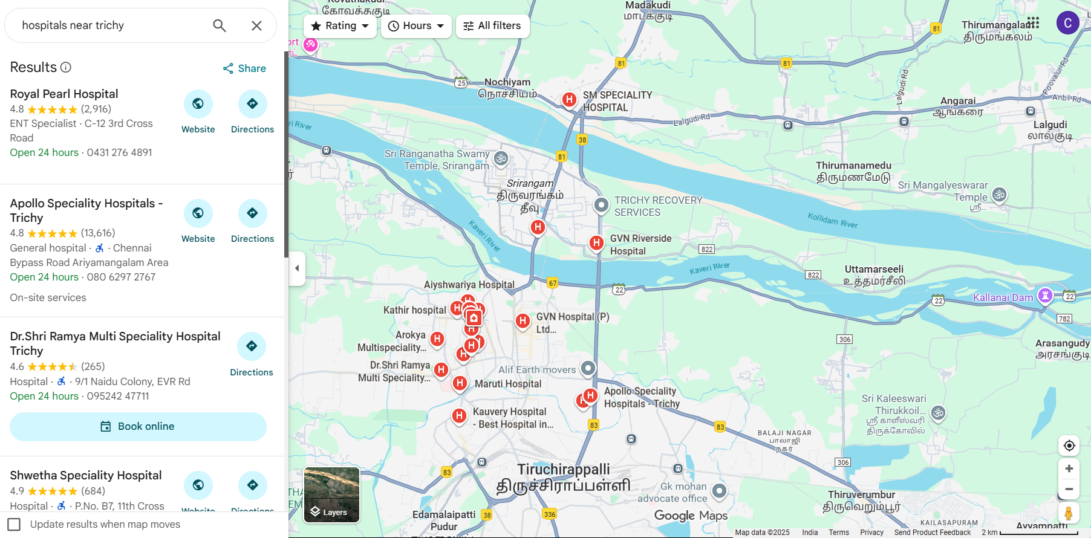
4.Hospital Locator & Nearby Medical Support
Uses device GPS and Geolocation API to detect nearby hospitals within a defined radius.
Displays hospital details such as distance, maps route, and contact options.

Slide 15
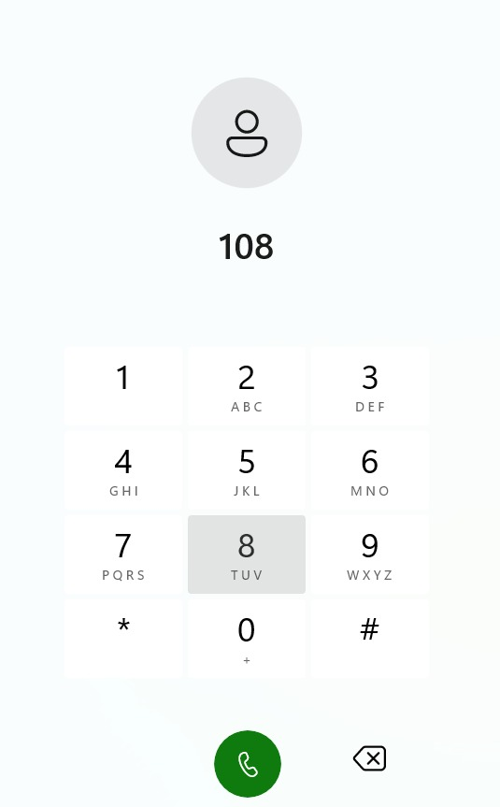
5.Emergency Assistance Module
Provides an emergency call feature for high-severity symptom cases detected by the system.
Uses severity analysis from the LLM to trigger emergency alerts and safety prompts.

Slide 16
CONCLUSION
The Medi Portal system successfully demonstrates how modern AI technologies can enhance early health assessment. By combining LLM-based symptom analysis, RAG-supported medical retrieval, and real-time hospital assistance, the system delivers accurate, personalized, and accessible health recommendations. It overcomes the limitations of traditional rule-based symptom checkers by understanding natural language, offering tailored guidance, and providing emergency support when needed. Overall, the system provides a reliable and efficient platform that improves user safety, medical awareness, and healthcare accessibility.

Slide 17
FUTURE ENHANCEMENTS
Allow users to speak symptoms instead of typing, improving accessibility and ease of use.
Add real-time chat or video consultation with certified doctors for professional medical assistance.
Automatically trigger emergency alerts when severe symptoms or dangerous patterns are detected.
Create downloadable reports summarizing symptoms, predictions, and recommendations for medical visits.
Enable symptom analysis and recommendations in multiple languages for broader user accessibility.

Slide 18
REFERENCES
Sinha, P. – Symptom Checker using static dataset; limited AI capability (PHP, MySQL).
Gupta, S. – Disease diagnosis using Decision Tree; low accuracy for multi-symptom cases.
Thomas, L. – Hospital Finder web app; only region-based search (Google Maps API).
Verma, R. – Basic health chatbot; rule-based replies, no disease prediction (Python, AIML).
Existing Works Summary – Prior systems lack AI reasoning, RAG integration, and severity-based suggestions.

Slide 19


